Slide 1
Online Food Delivery System
FOOD BOX
Team Members
Gayatri Sulkar
Mayuri Dilip Yadav
Sunena Saikia
Jammuladinne Vineela
Pratiksha Thorbole
Sujal Upadhyay
Mule Kalyanreddy
Gnana Kumar R
Ramanjineyulu D
Dinesh S

Slide 2
INTRODUCTION
The project Online Food ordering system is a web-based application that allows the administrator to handle all the activities online quickly and safely. Using Interactive GUI anyone can quickly learn to use the complete system.
Using this, the administrator doesn’t have to sit and manage the entire activities on paper, and at the same time, the head will feel comfortable to keep check of the whole system. This system will give him power and flexibility to manage the entire system from a single online portal.
Customer can also enjoy ordering Food sitting at home with ease of accessing our application.

Slide 3
Objective of our Project
Our proposed system is an online food ordering system that enables ease for the customers. It overcomes the disadvantages of the Traditional queueing system. This system improves the method of taking the order from customer.
The online food ordering system sets up a food menu online and customers can easily place the order as per their wish. Also with a food menu, customers can easily track the orders.
The payment can be made online or pay-on-delivery system. For more secured ordering separate accounts are maintained for each user by providing them an ID and a password.

Slide 4
Existing System
In existing system for giving any orders users should visit hotels or restaurants to know about food items and them give order and pay advance.
In this method time and manual work is required.
Maintaining critical information in the files and manuals is full of risk and a tedious process.
Time consuming process .

Slide 5
PROPOSED SYSTEM
Our proposed System helps to make food ordering simple and to deliver food at the doorstep.
Customers can choose their favorite food ,order and make payments online.
This system helps to reduce the time of customers and get Quality foods on time.

Slide 6
TECHNOLOGIES USED
Number | Description | Type
1 | Front-End | Angular Framework by Google
2 | Back-End | Spring Boot
3 | Database | MySQL
4 | Server | Apache Tomcat
5 | IDE | Eclipse and Visual Studio Code
6 | Testing Tools | Postman and Junit Framework

Slide 7
LIST OF MODULES
Administrator module:
This module is used to create usernames and passwords by admin.
View customer details
Create/Update product categories and functionalities
Edit / delete product categories and descriptions
View and manage orders and sales report.
Customer Module:
This Functionalities provided:
View product’s list
Register /Sign in
Place orders
Make payments

Slide 8
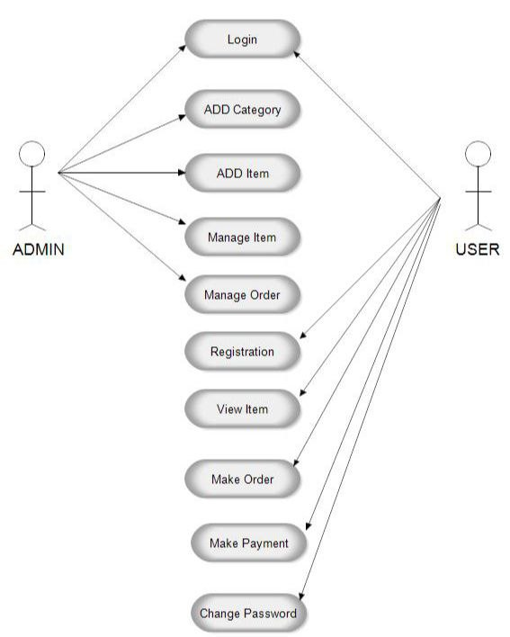
UML DIAGRAM

Slide 9
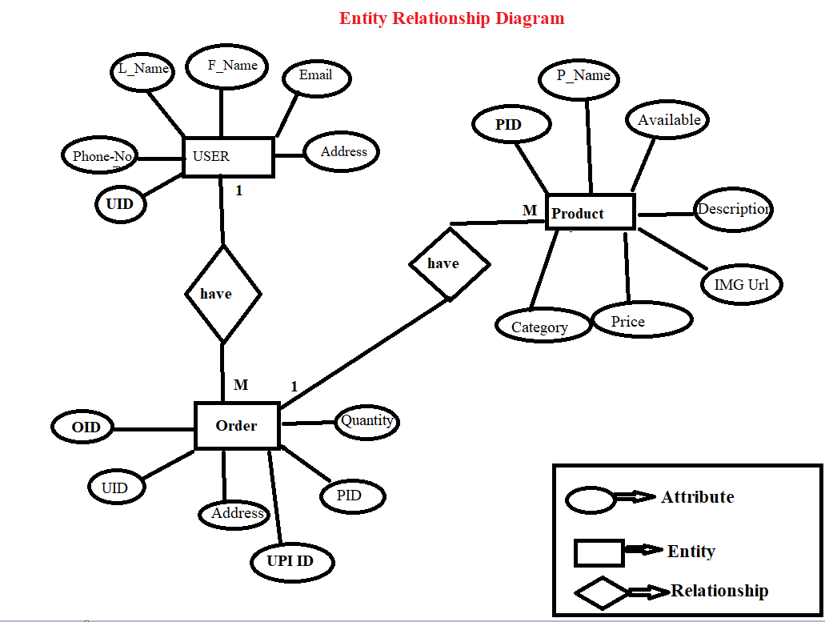
ENTITY RELATIONSHIP DIAGRAM

Slide 10
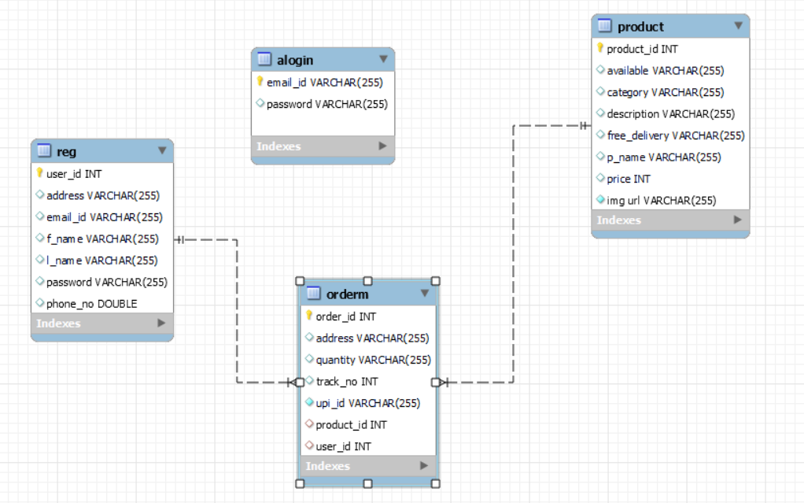
DATABASE SCHEMA

Slide 11
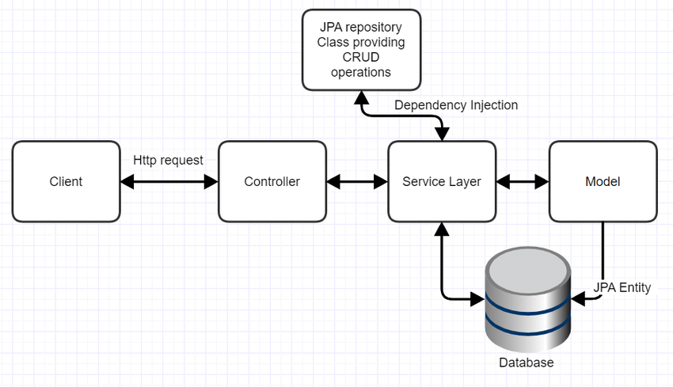
Spring MVC PATTERN

